Slide 1

PLM Business Case
Supporting industry partners in decision making:
  Why: the business case;
  What: the processes and project which are going to use PLM and the PLM modules;
  Where: the departments or sites that will implement PLM;
  When: the correct timing for PLM implementation;
  Who: the implementation personals.
Costs
Benefits

Slide 2
PLM Business Case
=
?
BENEFITS
COSTS
Business Performance
The Organization
PLM Benefits for
Users
Process Performance
Product or Service

Slide 3
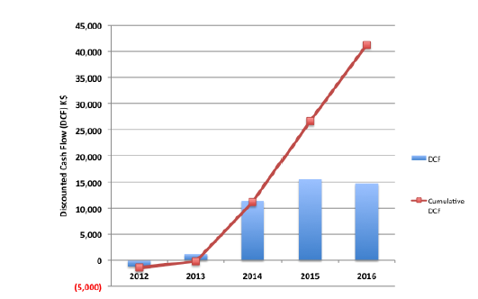
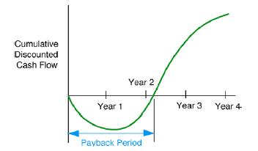
PLM Business Case
Cost/Benefit Analysis for Audit
Cost/Benefit Analysis for Implementation
Cost/Benefit Analysis for Feasibility
Discounted Cash Flows*
Payback Period*
* CIMdata, PLM Benefits Appraisal Guide, 5th Edition, Jan 2012

Slide 4
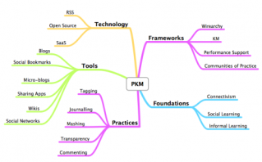
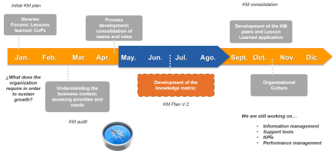
PLM Technology Roadmap
Identify the needs and capability gaps to achieving innovation in Product Lifecycle Management (PLM) research through to 20??
Determine priority actions to meet these needs and build capability to enable innovation in PLM.
Identify technology alternatives and milestones for meeting the needs and filling the gaps.

Slide 5
PLM Technology Roadmap
Preliminary Activities
Development of the Roadmap
Follow-up activities
1. Identify the critical system requirements and their targets.
2. Specify the major technology areas.
3. Specify the technology drivers and their targets.
4. Identify technology alternatives and their time lines.
5. Recommend the technology alternatives that should be pursued.
6. Create the technology roadmap report.
1. Satisfy essential conditions
2. Provide leadership/ sponsorship
3. Define the scope and boundaries for the roadmap
1. Critique and validate the roadmap.
2. Develop an research plan.
3. Review and update.

Slide 6

PLM Technology Roadmap
Executive Summary
Purpose of the Report
Critical Requirements
  3.1 Implementation
  3.2 Interface and Integration
  3.3 Security
  Priority Technical Areas
    4.1 Priority Technical Areas
    4.2 Technology Drivers for Each Area
    4.3 Technology Alternative for Each Area
    4.4 Recommendations
  Conclusions
  Next Steps
The Future of Product Lifecycle Management
Example

